Slide 1


Trajectory-Learning-and-Optimized-Tracking-in-Simulated-2D-Sp
YOUSSEF GHAOUI

Slide 2
1.
Key Points
The motion equation of a shuttlecock’s flying trajectory could be constructed by determining the terminal velocity in aerodynamics.
Air drag force is proportional to the square of a shuttlecock velocity. Furthermore, the angle and strength of a stroke could influence trajectory.
3

Slide 3
2.
Potential Purpose
As of the instabilty of the shuttlecock movement, basic object tracing system could loose sight of the item while exchanges between players, so a proposed solution would be to use a PiNN to be able to introduce information about trajectory of the shuttlecock in case of a lose of sight. For that matter, we could predict the potential cordinates of the shuttlecock at that point and finally potential capture it at a forward timestamp so we can be able to retrack it again.
Why not just use the physics based equations
air Resistance, inaccuration values could make the eqaution invalid, so when we use a neural network for this matter when maitain the intuation behind the equations, while helping the NN (make approximations) to remove incenrtenty and make correct predictions
3

Slide 4
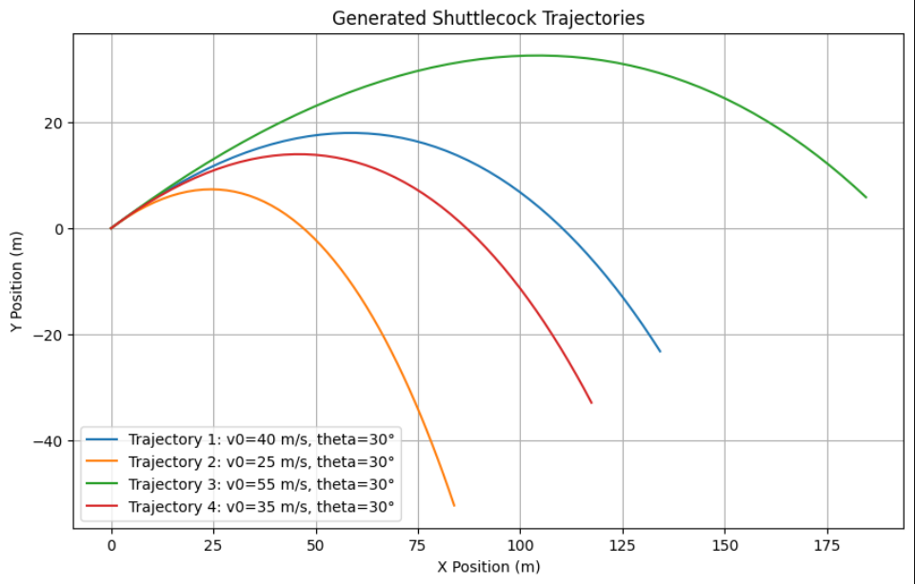
2.
Data Generation
Based on predefined trajectory equations of the shuttlecock, we are generated some data and going to teach our model to make predction of the variables needed x(t), y(t)
3

Slide 5
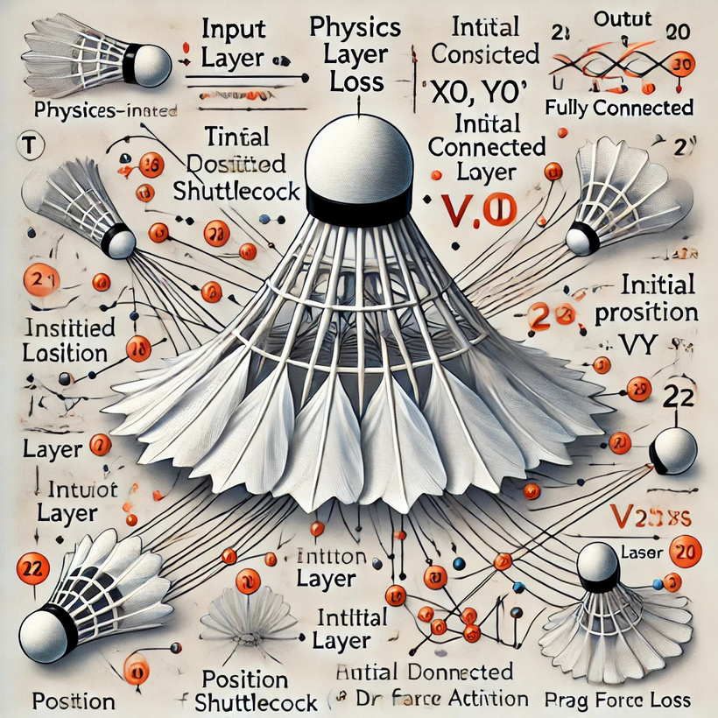
3.
Importance of Loss
Since we are building an NN, we are surely used some data as for training, for that matter we automatically use a data based loss. But, in order to incorporate the physics knowledge,we need to either change the loss data, or to make a concurrent combination between it and the physics loss function
3

Slide 6
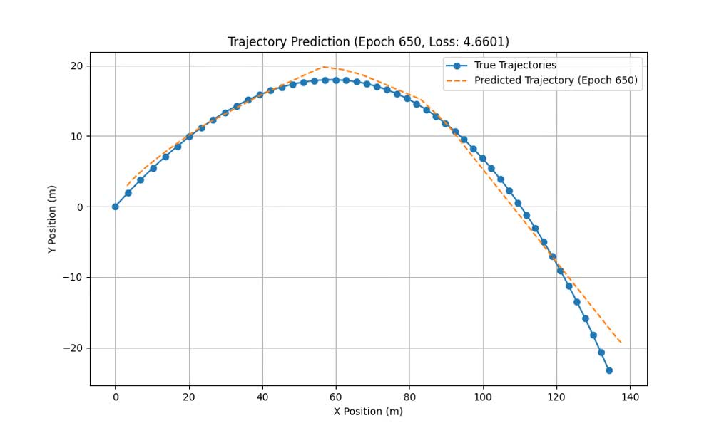
4.
Training
In order to simplify the problem, we are going to only use one generated exemple
Training using data based loss only ( MSE Loss )
The problem here is when using data only we might need a huge umber of samples in roder to make the NN predcit trajectories
3

Slide 7
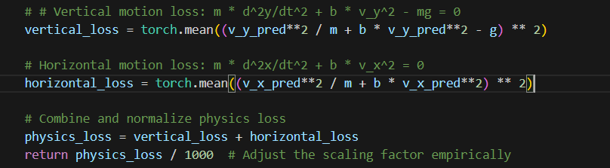
4.
Introduction of Physics based loss
We are going to reduce the number of points included in the training to 5.
So now basically, we are going to take a distant sample from a trajectory, and then make our modelmake prodiction on the trjectory from the point i to that next point j.
So if the timestep corresponds to one of the 5 points, we use the data loss, otherwise we stick to the physics based loss
We are going to include a scaled version loss of the Horizantal motion loss
and Vertical motion loss
and our model will only predict X, Y since vx ad vy are can be exctract by them
3

Slide 8
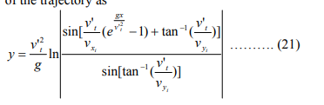
Potential consideration
We also coulve used this equation for be included in loss ( even tho it is a coupling of both the outputs y, and x)
3

Slide 9
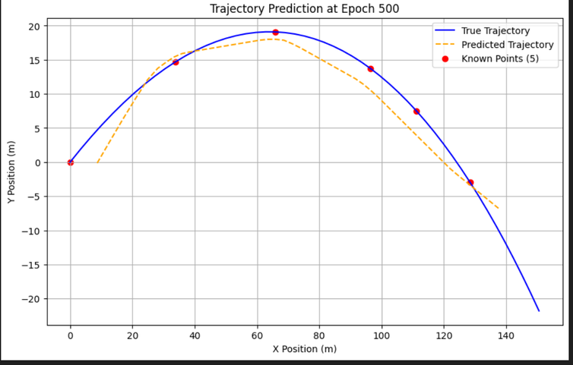
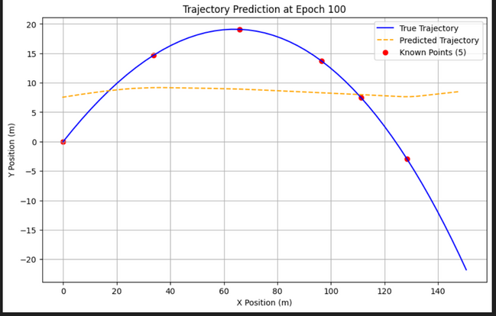
4.
Results of 500 epoch training
There visualization of the trianing phase on 5 sample using a combination o f data loss and pysics loss
3

Slide 10
Merci
https://github.com/GhaouiYoussef/Trajectory-Learning-and-Optimized-Tracking-in-Simulated-2D-Space
youssef.ghaoui@ensi-uma.tn

